Slide 1

GUVI Geek Network Pvt Ltd
Notes:
Need to convert these points into icons with text

Slide 2
Git & GitHub

Slide 3

Git
Git is a version control system (VCS)
Version Control System is a tools that helps to track changes in code
Git is a Version Control System. It is :
popular
free & Open Source
fast & scalable
Tracks every change (who changed what & when)
Allows multiple developers to work on the same project
Supports branching (work on features without affecting main code)
Works locally on your system (no internet required)
https://www.guvi.in/

Slide 4
GitHub
GitHub is a cloud-based platform that uses Git
It is a website where you store your Git projects online and collaborate with others
It allows developers to store and manage their code using Git
https://www.guvi.in/

Slide 5
GitHub Account
Create Account in GitHub and Login
URL : https://github.com/
Create a new repository
Make your first commit
It stores the commit in the form of history
https://www.guvi.in/

Slide 6
Git Setup
Visual Studio Code Setup
Windows (Git bash)
Mac (terminal)
git --version
https://www.guvi.in/

Slide 7
Git Configure
git config --global user.name “My Name”
git config --global user.email “myemail@gmail.com”
git config --list
https://www.guvi.in/

Slide 8
Clone & Status
clone : Cloning a repository on our local machine
git clone <some-link>
status: display the state of code
git status
https://www.guvi.in/

Slide 9
untracked : new file that git doesn’t yet track
modified : changed
staged : file is ready to be committed
unmodified : unchanged
https://www.guvi.in/

Slide 10
Add & Commit
add : add new or changed files in your working directory to the git staging area
git add<-filename->
commit: it is record the change
git commit -m “some message”
https://www.guvi.in/

Slide 11
Push Command
push : upload local repo content to remote repo
git push origin main
https://www.guvi.in/

Slide 12
Init Command
init : used to create a new git repo
git init
git remote add origin <- link->
git remote –v ( to verify remote)
git branch (to check branch)
git branch –M main (to rename branch)
git push origin main
https://www.guvi.in/

Slide 13
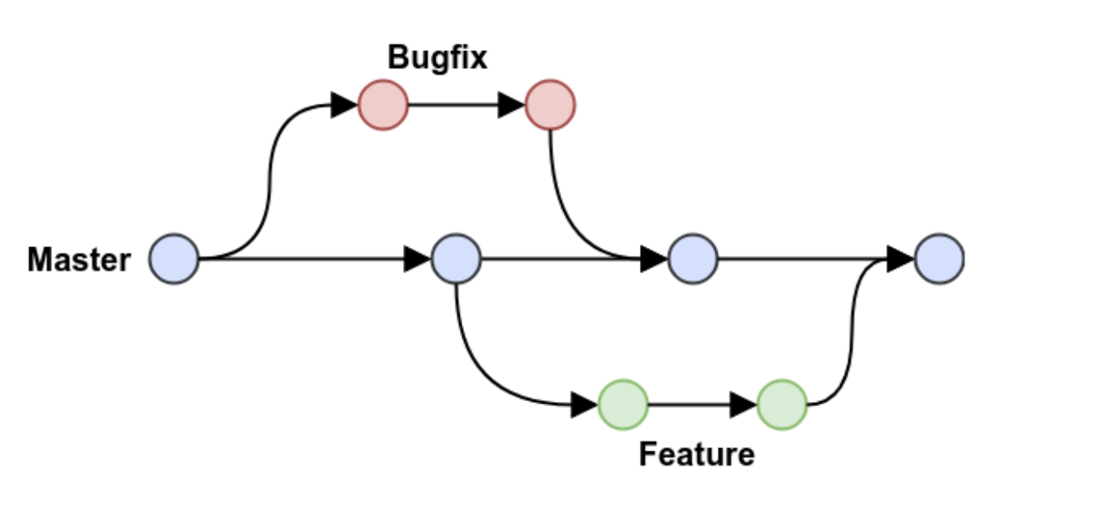
Git Branches
https://www.guvi.in/

Slide 14
Branch Command
git branch ( to check branch)
git branch –M main ( to rename branch )
git checkout <-branch name-> ( to navigate )
git checkout –b <-branch name-> ( to create new branch )
git branch –d <-branch name-> ( to delete branch)
https://www.guvi.in/

Slide 15
Merge Code
git diff <-branch name-> (to compare commits, branches, files & more )
git merge <- branch name-> ( to merge 2 branches)
https://www.guvi.in/

Slide 16
Pull Command
git pull origin main
used to fetch and download content from remote repo and immediately update the local repo to match the content.
https://www.guvi.in/

Slide 17
Fork
A fork is a new repository that share code and visibility settings with the original “upstream” repository
Fork is a rough copy
https://www.guvi.in/

Slide 18
Thank You

